Slide 1


Course Title: Programming Fundamentals Course Code: CS141
Assiut University
كلية معتمدة من الهيئة القومية
لضمان جودة التعليم والاعتماد
Prof. Khaled F. Hussain

Slide 2
Input/Output

Slide 3
Reference
D. S. Malik, “C++ Programming: From Problem Analysis to Program Design”, Cengage Learning

Slide 4
I/O Streams and Standard I/O Devices
A stream is a sequence of characters from the source to the destination.
There are two types of streams:
Input stream: A sequence of characters from an input device to the computer.
Output stream: A sequence of characters from the computer to an output device.
The standard input device is usually the keyboard, and the standard output device is usually the screen.

Slide 5
I/O Streams and Standard I/O Devices (Cont.)
The header file iostream contains, among other things, the definitions of two data types, istream (input stream) and ostream (output stream).
The header file also contains two variable declarations:
cin, which stands for common input.
cout, which stands for common output.
To use cin and cout, the preprocessor directive #include <iostream> must be used
Variables of type istream are called input stream variables; variables of type ostream are called output stream variables.

Slide 6
I/O Streams and Standard I/O Devices (Cont.)
Consider the input 25 and the statement:
cin >> a;
If a is of the data type char, only the single character 2 is stored in a.
If a is of the data type int, 25 is stored in a.
Consider the input 25.56 and the statement:
cin >> b;
If b is of the data type int, 25 is stored in b.
If b is of the data type float, 25.56 is stored in b.
cin >> a_int >> ch >> z_double; input: 57A26.9 a_int = 57, ch = 'A’, z_double = 26.9

Slide 7

Using Predefined Functions in a Program
C++ comes with a wealth of functions, called predefined functions
pow, called the power function, can be used to calculate x^{y} in a program. That is,
pow(x, y) = x^{y}.
The header file cmath contains the specification of the function pow.
To use a predefined function in a program, you need to know the name of the header file containing the specification of the function and include that header file in the program.
The function sqrt, header file cmath

Slide 8
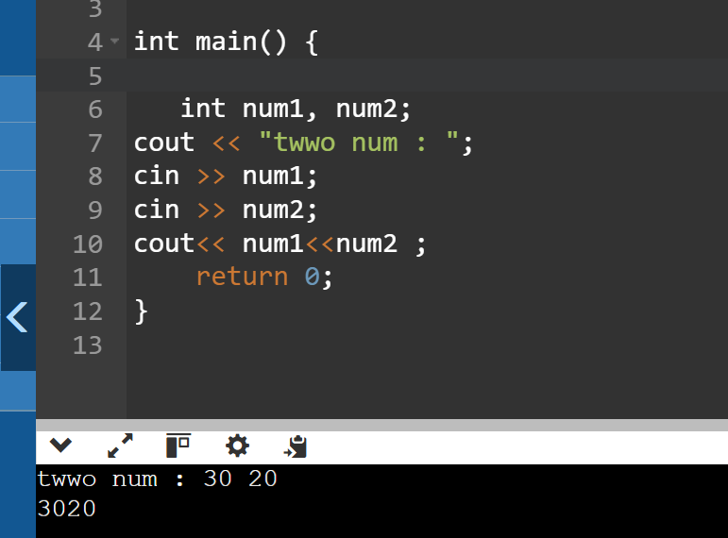
cin and the get Function
cin.get(varChar);
The get function inputs the next character, including whitespace characters
cin.get(ch1);
cin.get(ch2);
cin >> num;
Now consider the following input again:
A 25
To store 'A' in ch1, the blank in ch2, and 25 in num,
The preceding set of cin.get statements is equivalent to the following statements:
cin >> ch1;
cin.get(ch2);
cin >> num;

Slide 9
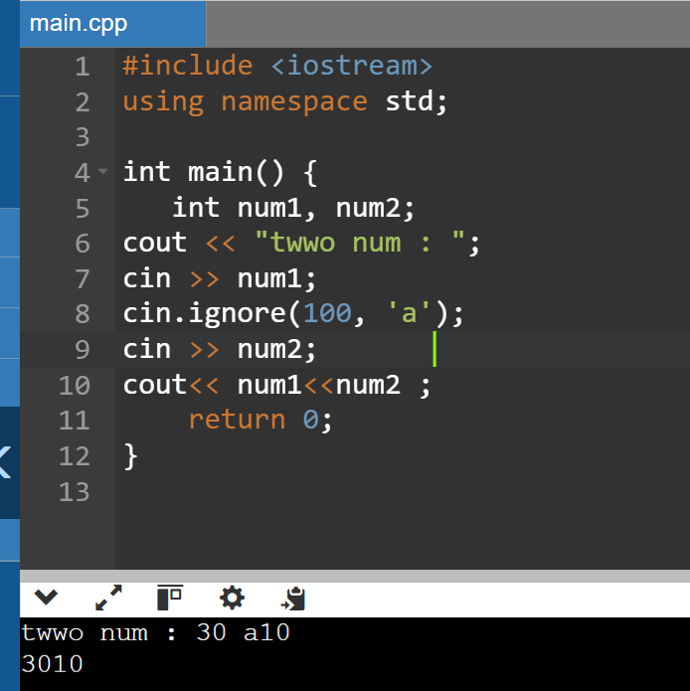
cin and the ignore Function for char
cin.ignore(intExp, chExp);
cin.ignore(100, '\n’);
When this statement executes, it ignores either the next 100 characters or all characters until the newline character is found, whichever comes first.
cin.ignore(100, 'A');
When this statement executes, it ignores either the next 100 characters or all characters until the character 'A’ is found, whichever comes first.

Slide 10
The putback and peek functions
ch = istreamVar.peek();
The stream function peek looks into the input stream and tells you what the next character is without removing it from the input stream.
istreamVar.putback(ch);
The stream function putback lets you put a character back into the input stream.

Slide 11
Input Failure (Example1)
int a, b, c;
double x;
If the input is:
W 54
then the statement:
cin >> a >> b;
would result in an input failure, because you are trying to input the character 'W' into the int variable a.

Slide 12
The clear Function
istreamVar.clear();
When an input stream enters the fail state, the system ignores all further I/O using that stream. You can use the stream function clear to restore the input stream to a working state.
After using the function clear to return the input stream to a working state, you still need to clear the rest of the garbage from the input stream. This can be accomplished by using the function ignore.

Slide 13
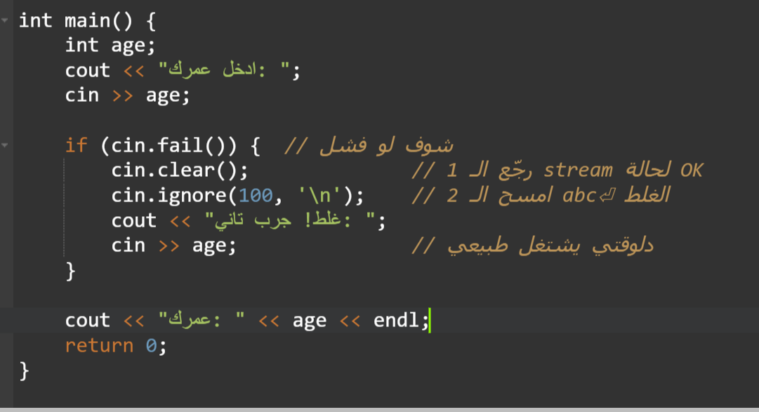
Input failure and the clear function
#include <iostream>
using namespace std;
int main()
{
int a = 23; //Line 1
int b = 34; //Line 2
cout << "Line 3: Enter a number followed"
<< " by a character: "; //Line 3
cin >> a >> b; //Line 4
cout << endl << "Line 5: a = " << a << ", b = " << b << endl; //Line 5
cin.clear(); //Restore input stream; Line 6
cin.ignore(200,'\n'); //Clear the buffer; Line 7
cout << "Line 8: Enter two numbers: "; //Line 8
cin >> a >> b; //Line 9
cout << endl << "Line 10: a = " << a << ", b = " << b << endl; //Line 10
return 0;
}

Slide 14
Sample Run
In this sample run, the user input is shaded.
Line 3: Enter a number followed by a character: 78 d
Line 5: a = 78, b = 34
Line 8: Enter two numbers: 65 88
Line 10: a = 65, b = 88

Slide 15
Output and Formatting Output
cout << expression or manipulator << expression or manipulator...;
Manipulator is used to format the output

Slide 16
setprecision Manipulator
The general syntax of the setprecision manipulator is:
setprecision(n)
where n is the number of decimal places.
To use the manipulator setprecision, the program must include the header file iomanip. Thus, the following include statement is required:
#include <iomanip>

Slide 17
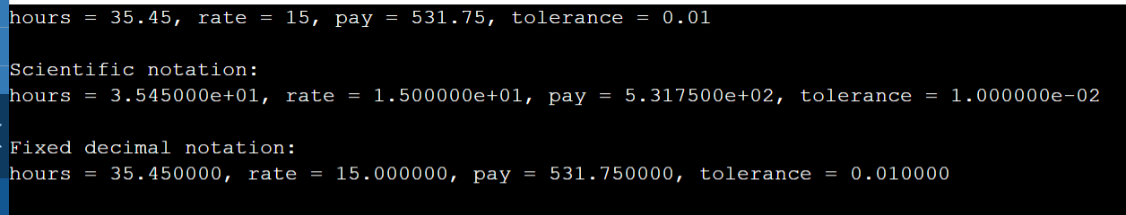
fixed and scientific Manipulators
#include <iostream>
#include <iomanip>
using namespace std;
int main() {
double hours = 35.45;
double rate = 15.00;
double tolerance = 0.01000;
cout << "hours = " << hours << ", rate = " << rate << ", pay = " << hours * rate << ", tolerance = " << tolerance << endl << endl;
cout << scientific;
cout << "Scientific notation: " << endl;
cout << "hours = " << hours << ", rate = " << rate << ", pay = " << hours * rate << ", tolerance = " << tolerance << endl << endl;
cout << fixed;
cout << "Fixed decimal notation: " << endl;
cout << "hours = " << hours << ", rate = " << rate << ", pay = " << hours * rate << ", tolerance = " << tolerance << endl << endl;
return 0; }

Slide 18
Sample Run:
hours = 35.45, rate = 15, pay = 531.75, tolerance = 0.01
Scientific notation:
hours = 3.545000e+001, rate = 1.500000e+001, pay = 5.317500e+002, tolerance = 1
.000000e-002
Fixed decimal notation:
hours = 35.450000, rate = 15.000000, pay = 531.750000, tolerance = 0.010000

Slide 19
How to select decimals
#include <iostream>
#include <iomanip>
using namespace std;
int main() {
// initialize a floating-point
float num = 2.71828;
cout << "Original number is: " << num;
cout << "\n";
// print 3 significant figures
cout << "The number with 3 significant figures is: ";
cout << setprecision(3) <<num << endl;
// print 3 decimal places
cout << "The number with 3 decimal places is: ";
cout << fixed << setprecision(3) << num;
cout << "\n\n";
return 0;
}

Slide 20
Sample Run
Original number is: 2.71828
The number with 3 significant figures is: 2.72
The number with 3 decimal places is: 2.718

Slide 21

showpoint Manipulator
Suppose that the decimal part of a decimal number is zero. In this case, when you instruct the computer to output the decimal number in a fixed decimal format, the output may not show the decimal point and the decimal part.
To force the output to show the decimal point and trailing zeros, you use the manipulator showpoint.

Slide 22
Example: setprecision, fixed, showpoint
#include <iostream> //Line 1
#include <iomanip> //Line 2
using namespace std; //Line 3
const double PI = 3.14159265; //Line 4
int main() //Line 5
{ //Line 6
double radius = 12.67; //Line 7
double height = 12.00; //Line 8
cout << fixed << showpoint; //Line 9
cout << setprecision(2) << "Line 10: setprecision(2)" << endl; //Line 10
cout << "Line 11: radius = " << radius << endl; //Line 11
cout << "Line 12: height = " << height << endl; //Line 12
cout << "Line 13: volume = “ << PI * radius * radius * height << endl; //Line 13
cout << "Line 14: PI = " << PI << endl << endl; //Line 14
cout << setprecision(3) << "Line 15: setprecision(3)" << endl; //Line 15
cout << "Line 16: radius = " << radius << endl; //Line 16
cout << "Line 17: height = " << height << endl; //Line 17
cout << "Line 18: volume = “ << PI * radius * radius * height << endl; //Line 18

Slide 23
cout << "Line 19: PI = " << PI << endl << endl; //Line 19
cout << setprecision(4) << "Line 20: setprecision(4)" << endl; //Line 20
cout << "Line 21: radius = " << radius << endl; //Line 21
cout << "Line 22: height = " << height << endl; //Line 22
cout << "Line 23: volume = “ << PI * radius * radius * height << endl; //Line 23
cout << "Line 24: PI = " << PI << endl << endl; //Line 24
cout << "Line 25: “ << setprecision(3) << radius << ", “ << setprecision(2) << height << ", "
<< setprecision(5) << PI << endl; //Line 25
return 0; //Line 26
} //Line 27

Slide 24
Sample Run
Line 10: setprecision(2)
Line 11: radius = 12.67
Line 12: height = 12.00
Line 13: volume = 6051.80
Line 14: PI = 3.14
Line 15: setprecision(3)
Line 16: radius = 12.670
Line 17: height = 12.000
Line 18: volume = 6051.797
Line 19: PI = 3.142
Line 20: setprecision(4)
Line 21: radius = 12.6700
Line 22: height = 12.0000
Line 23: volume = 6051.7969
Line 24: PI = 3.1416
Line 25: 12.670, 12.00, 3.14159

Slide 25
setw
The manipulator setw is used to output the value of an expression in a specific number of columns.
The output is rightjustified.
To use the manipulator setw, the program must include the header file iomanip. Thus, the following include statement is required:
#include <iomanip>

Slide 26
setfill Manipulator
ostreamVar << setfill(ch);
The output stream variables can use the manipulator setfill to fill the unused columns with a character other than a space
cout << setfill('#’);

Slide 27
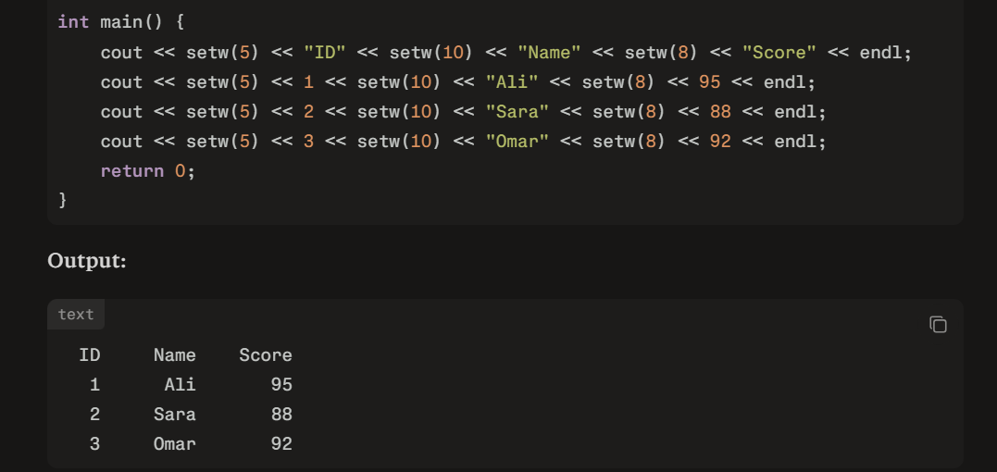
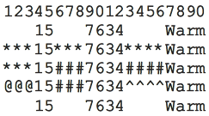
Example
#include <iostream>
#include <iomanip>
using namespace std;
int main() {
int x = 15; //Line 1
int y = 7634; //Line 2
cout << "12345678901234567890" << endl; //Line 3
cout << setw(5) << x << setw(7) << y << setw(8) << "Warm" << endl; //Line 4
cout << setfill('*'); //Line 5
cout << setw(5) << x << setw(7) << y << setw(8) << "Warm" << endl; //Line 6
cout << setw(5) << x << setw(7) << setfill('#’) << y << setw(8) << "Warm" << endl; //Line 7
cout << setw(5) << setfill('@') << x << setw(7) << setfill('#') << y << setw(8) << setfill('^') << "Warm“ << endl; //Line 8
cout << setfill(' '); //Line 9
cout << setw(5) << x << setw(7) << y << setw(8) << "Warm" << endl; //Line 10
return 0; }

Slide 28
left and right Manipulators
ostreamVar << right;
ostreamVar << left;
cout << left;
The statement sets the output to be left-justified on the standard output device

Slide 29
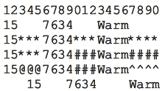
Example
#include <iostream>
#include <iomanip>
using namespace std;
int main() {
int x = 15; //Line 1
int y = 7634; //Line 2
cout << left; //Line 3
cout << "12345678901234567890" << endl; //Line 4
cout << setw(5) << x << setw(7) << y << setw(8) << "Warm" << endl; //Line 5
cout << setfill('*'); //Line 6
cout << setw(5) << x << setw(7) << y << setw(8) << "Warm" << endl; //Line 7
cout << setw(5) << x << setw(7) << setfill('#’) << y << setw(8) << "Warm" << endl; //Line 8
cout << setw(5) << setfill('@') << x << setw(7) << setfill('#') << y << setw(8) << setfill('^') << "Warm“ << endl; //Line 9
cout << right; //Line 10
cout << setfill(' '); //Line 11
cout << setw(5) << x << setw(7) << y << setw(8) << "Warm" << endl; //Line 12
return 0; }

Slide 30
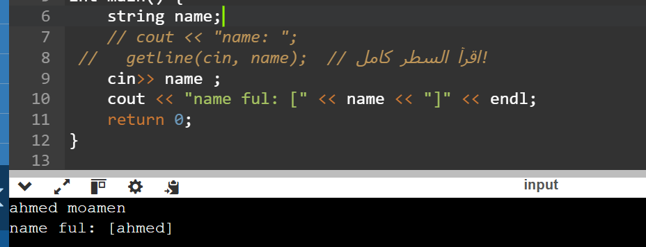
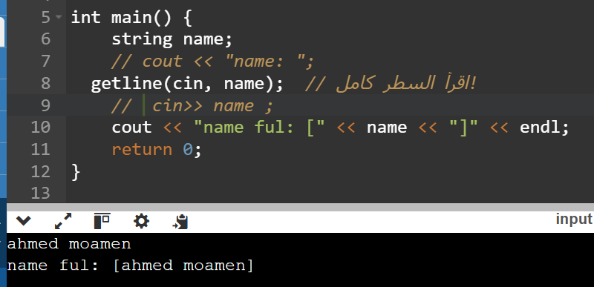
getline
getline(istreamVar, strVar);
The reading is delimited by the newline character '\n'.
The function getline reads until it reaches the end of the current line. The newline character is also read but not stored in the string variable.
string myString;
getline(cin, myString);

Slide 31
Files
To read a file
We must know its name
We must open it (for reading)
Then we can read
Then we must close it
That is typically done implicitly
To write a file
We must name it
We must open it (for writing)
Or create a new file of that name
Then we can write it
We must close it
That is typically done implicitly

Slide 32
File
#include <iostream>
#include <fstream>
using namespace std;
int main () {
ofstream myfile;
myfile.open ("example.txt");
myfile << "Writing this to a file.\n";
myfile.close();
return 0;
}

Slide 33
File
#include <iostream>
#include <fstream>
using namespace std;
int main () {
ofstream myfile ("example.txt");
if (myfile.is_open())
{
myfile << "This is a line.\n";
myfile << "This is another line.\n";
myfile.close();
}
else cout << "Unable to open file";
return 0;
}

Slide 34
File
#include <iostream>
#include <fstream>
#include <string>
using namespace std;
int main () {
string line;
ifstream myfile ("example.txt");
if (myfile.is_open()) {
//3. قراءة سطر بسطر
while ( getline (myfile,line) ) {
cout << line << '\n';
}
myfile.close();
}
else cout << "Unable to open file";
return 0;
}

